Slide 1


Library System Management PROJECT
Made by Neetu Chaurasia

Slide 2
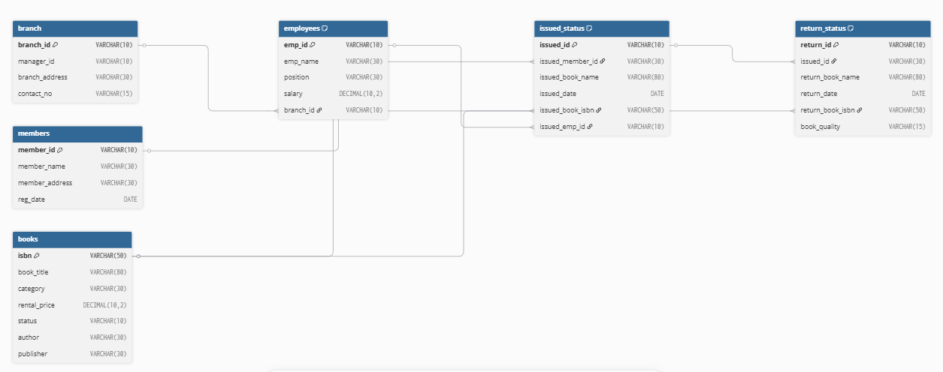
Database Schema Overview (Entity-relationship Diagram Of Library system management)

Slide 3


Create a New Book Record ("978-1-60129-456-2', 'To Kill a Mockingbird', 'Classic', 6.00, 'yes', 'Harper Lee', 'J.B. Lippincott & Co.')
Update an Existing Member's Address

Slide 4
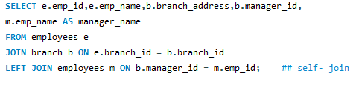

List Employees with Their Branch Manager's Name and their branch details
Retrieve the List of Books Not Yet Returned

Slide 5
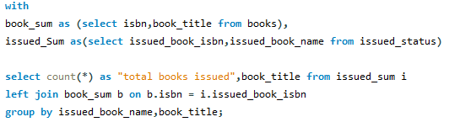
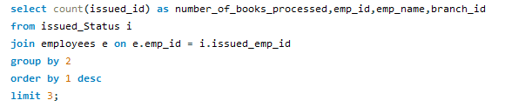
Use CTE and Retrieve each book and total time it is issued
Write a query to find the top 3 employees who have processed the most book issues. Display the employee name, number of books processed, and their branch.

Slide 6
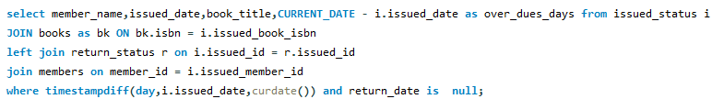
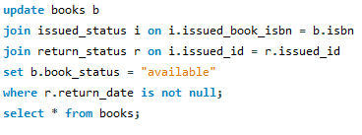
Write a query to identify members who have overdue books (assume a 30-day return period). Display the member's name, book title, issue date, and days overdue.
Write a query to update the status of books in the books table to "available" when they are returned (based on entries in the return_status table)

Slide 7
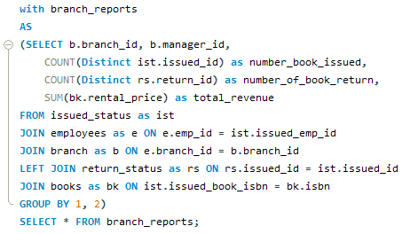
Create a query that generates a performance report for each branch, showing the number of books issued, the number of books returned, and the total revenue generated from book rentals.

Slide 8
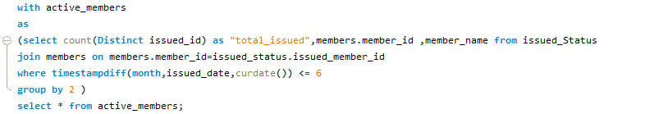
Show active_members containing members who have issued at least one book in the last 6 months.
Retrieve All Books in a Specific Category

Slide 9
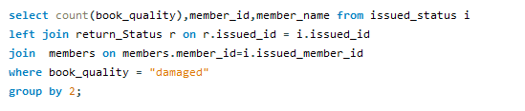
Write a query to identify members who have issued books with the book quality "damaged" in the return_status table. Display the member name, book title, and the number of times they've issued damaged books.
Find Total Rental Income by Category

Slide 10

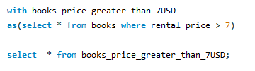
List Members Who Registered in the Last 180 Days
Find Books with Rental Price Above a Certain Threshold - i.e 7USD

Slide 11


Delete the record with issued_id = 'IS115' from the issued_status table.
Retrieve All Books Issued by a Specific Employee
List Members Who Have Issued More Than One Book

Slide 12
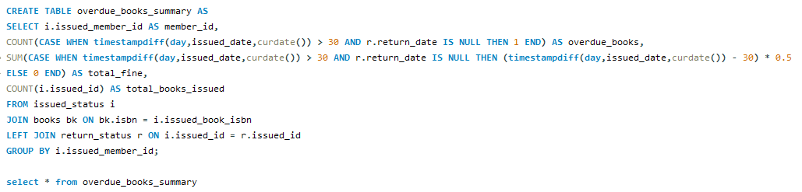
Write a CTAS query to create a new table that lists each member and the books they have issued but not returned within 30 days. The table should include: -- The number of overdue books. -- The total fines, with each day's fine calculated at $0.50. -- The number of books issued by each member.

